Slide 1
The Opioid Epidemic in Philadelphia
David Metzger, PhD
Cecile Denis, PhD
HIV Prevention Research Division
University of Pennsylvania
Department of Psychiatry
3535 Market Street
dsm@pennmedicine.upenn.edu

Slide 2
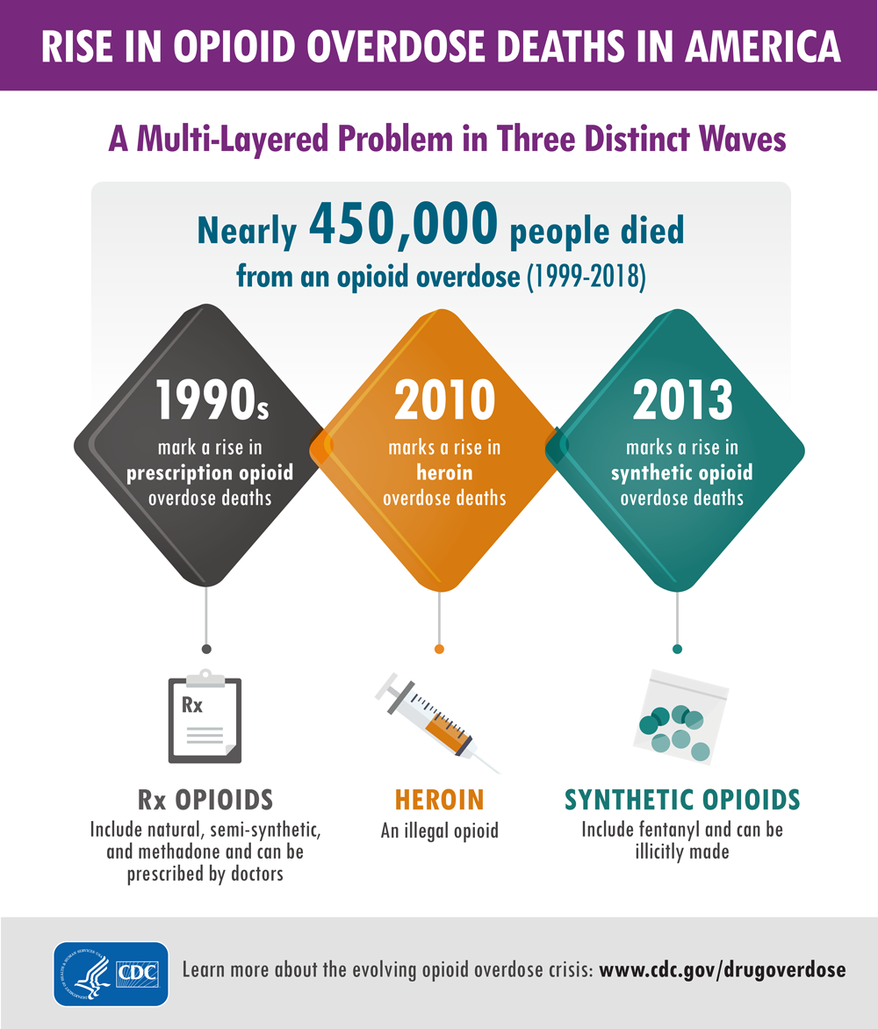

Slide 3
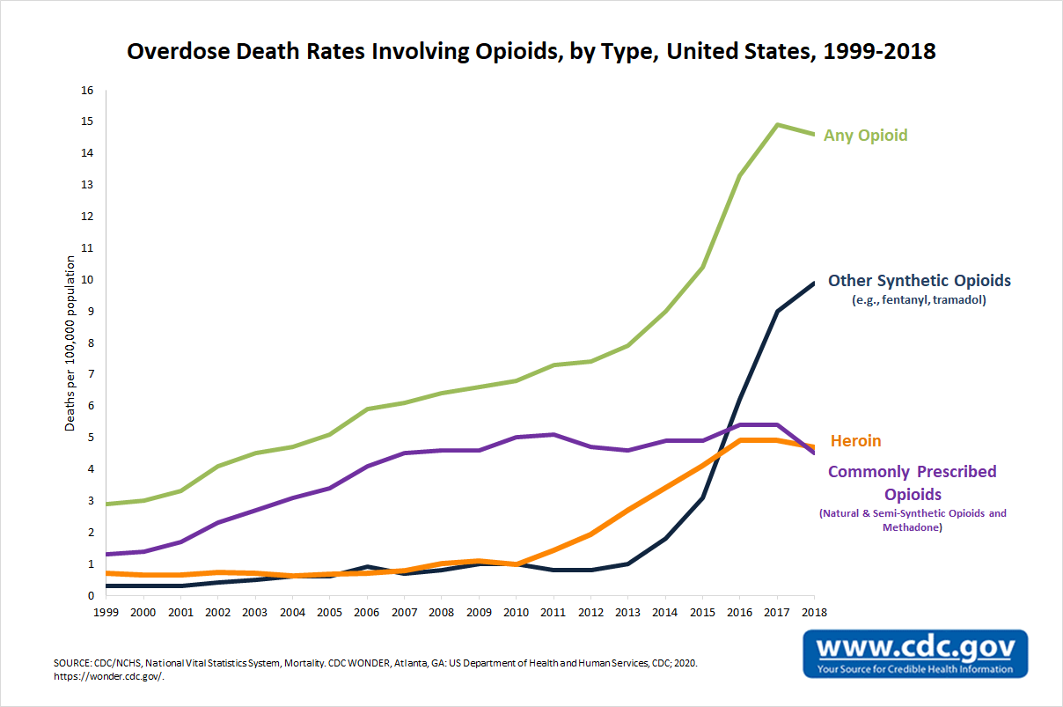
Opioids were involved in nearly 47,000 deaths in 2018, which is nearly six times the number of opioid-involved overdose deaths in 1999.

Slide 4
Notes:
Most people in the City know we have a serious problem with opioids. However, you may not be aware of just how serious the problem is compared to other Cities.

Slide 5








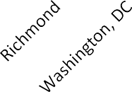






Heroin is pure and cheap in Philadelphia
80%
$2.50
Purity
Cost per milligram
70%
$2.00
60%
50%
$1.50
Cost per milligram
Purity
40%
30%
$1.00
20%
$0.50
10%
0%
$-
City
2015 Heroin Domestic Monitor Program
Notes:
The severity may have something to do with the cost and purity of the heroin available here. We have the purest and the cheapest heroin in the country. It is estimated that there are about 70,000 People who inject drugs and 50,000 who have problematic use of prescription opioids

Slide 6
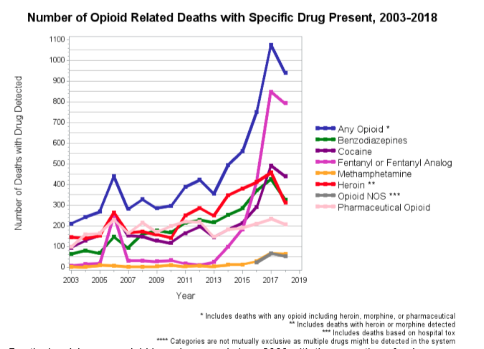

Slide 7
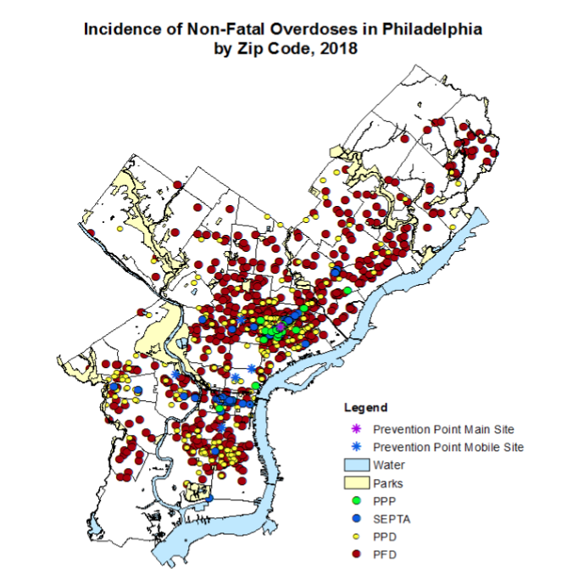
Notes:
There were non-fatal overdoses in Philadelphia in 2018. Every neighborhood is affected but there are high concentrations in Kensington, South Philly, West Philly, and the Near Northeast.

Slide 8
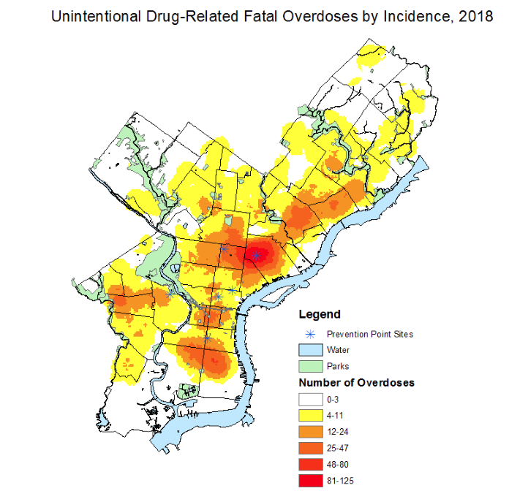
Notes:
There were 939 fatal overdoses in 2018. This map shows the areas where these deaths occurred.

Slide 9
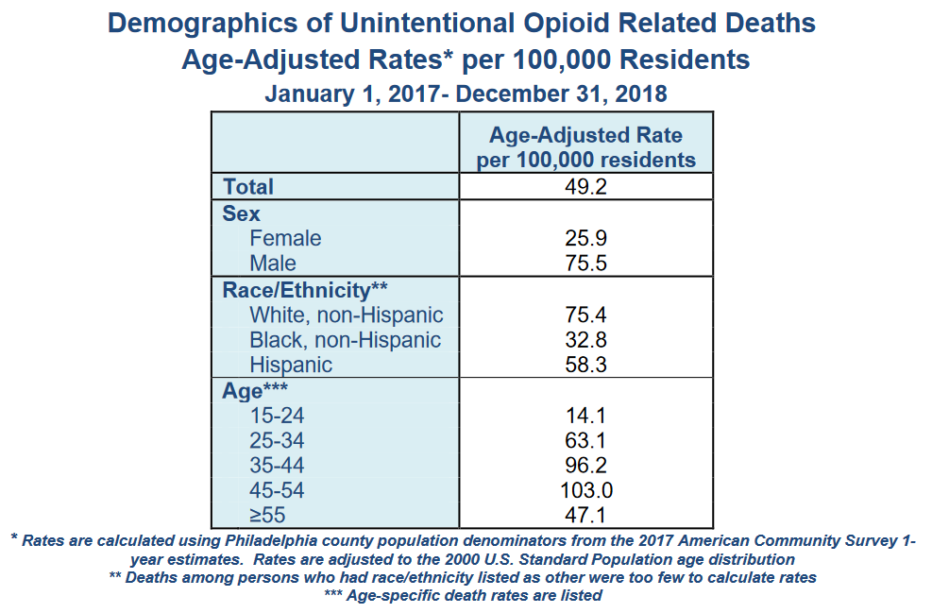
https://www.phila.gov/media/20200226121229/Substance-Abuse-Data-Report-02.26.20.pdf

Slide 10
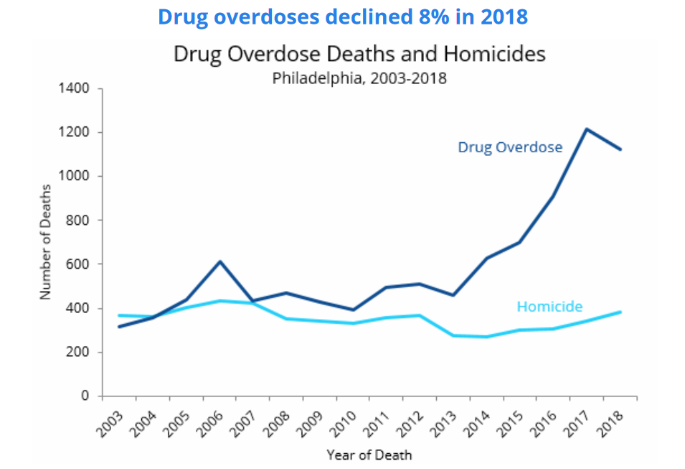
Opioid Use Disorder in Philadelphia
1,116 deaths
David Metzger, PhD
Cecile Denis, PhD
Penn Mental Health AIDS Research Center
University of Pennsylvania
Department of Psychiatry
3535 Market Street
dsm@pennmedicine.upenn.edu

Slide 11

993 fatal opioid overdoses
Opioid Use Disorder
in Philadelphia:
120,000 (est.)

Slide 12
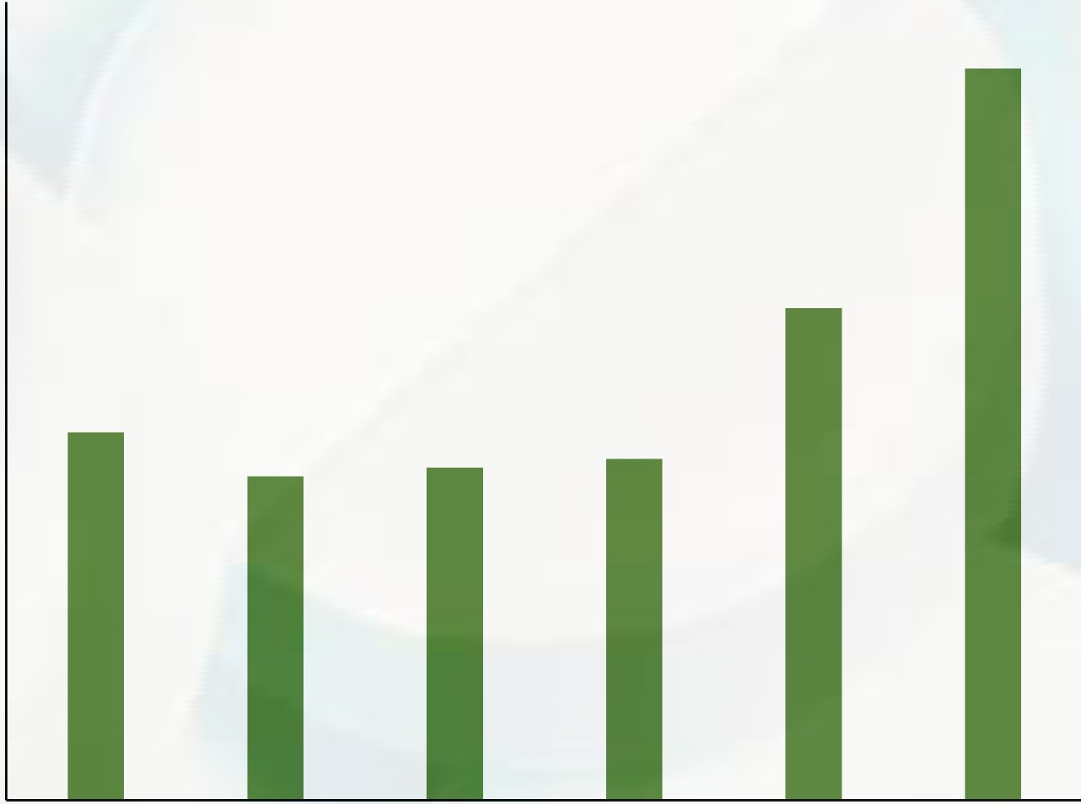



Increasing hepatitis C and endocarditis as well
Hospitalizations for Endocarditis Among People with Opioid Use Disorder by Year
Acute cases of hepatitis C reported to PDPH, 2012-2018
180
200
180
160
u
140
:..... ¹⁶⁰
Vl
C
0
ro
.....
o_{QJ}.. 140
ro 120
N
..c
120
ro
.-t:
100
::J
c..
u
Vl
0
I
ro 100
80
.....^{c}..
·3 ₈₀
Vl
ro
::J 60
40
20
0
'+-
0
I,,_
60
QJ
..c
"'O
I I
2013 2014
E
:
-
::J
z 40
"'O C
20
2012
2015
Year
2016
2017
2018
0
2012
2013
2014
2015
2016
2017
Department of
Public Health
DDC, Philadelphia Department of Public Healt h; PHC4

Slide 13
U.S. counties vulnerable to rapid spread of IDU-associated HIV
HIV Can Spread Rapidly Among People Who Inject Drugs
220 counties in 26 states
Kings County, WA. 27 HIV cases from IDU in 2018.
Scott County, 215 HIV cases from IDU in 2014-2015
Cabell County WV, 55 HIV Cases from IDU in 2019
Multnomah, OR. 42 HIV cases mostly IDU in 2018-2019.
Lowell and Lawrence, Mass. 129 HIV cases in IDU from 2015-2018 (from 2012-2014, entire Mass had 123 IDU cases).
Philadelphia, 71 HIV Cases from IDU in 2018 (115% increase from 2016)
Van Handel et al., J Acquir Immune Defic Syndr. 2016

Slide 14
Identifying an Outbreak
**Data as of 6/25/2019
Incomplete data due to reporting lag
Source: PDPH/AACO, 2019
Notes:
In late September 2018, PDPH identified an increase in HIV among PWID. This increase was identified through routine time/space analysis. Results of monthly code run by the Surveillance unit in September 2018 showed an increase in the number of HIV cases with PWID transmission risk dispersed in specific geographic regions of Philadelphia in the months of January and June 2018.
To date, Philadelphia has seen a significant increase in newly diagnosed PWID and PWID/ MSM. From 2016 (the last year with a decrease in new diagnoses) to 2018 there has been a 115% increase in new infections. Note, that investigation of cases for 2018 is not complete.

Slide 15
Number of new HIV/AIDS diagnoses among IDUs in Philadelphia by year: 1981 to 2014
Introduction of SEP
Introduction of ART
1981 1985 1990 1995 2000 2005 2010 2014

Slide 16
PMARC Pilot assessments of 143 PWID
HIV positive: 12 (8.4%)
Detectable VL: 7 (58.3%)
Severe DSM 5 OUD: 132 (92.8%)
OD past 6 months: 41 (32.3%)
MAT past 30 days: 46 (36.5%)
Depression:
Severe/Very Severe 57 (40%)

Slide 17
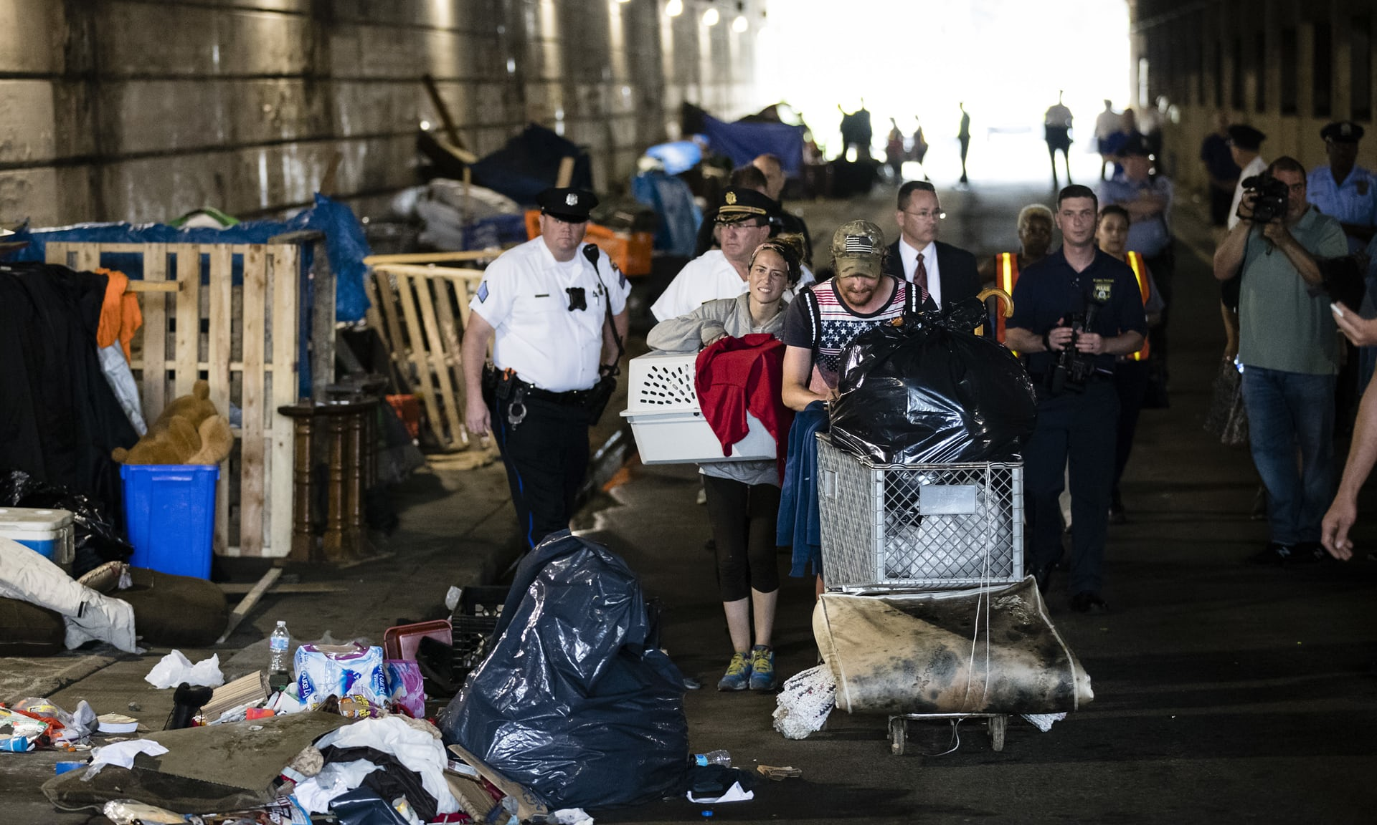
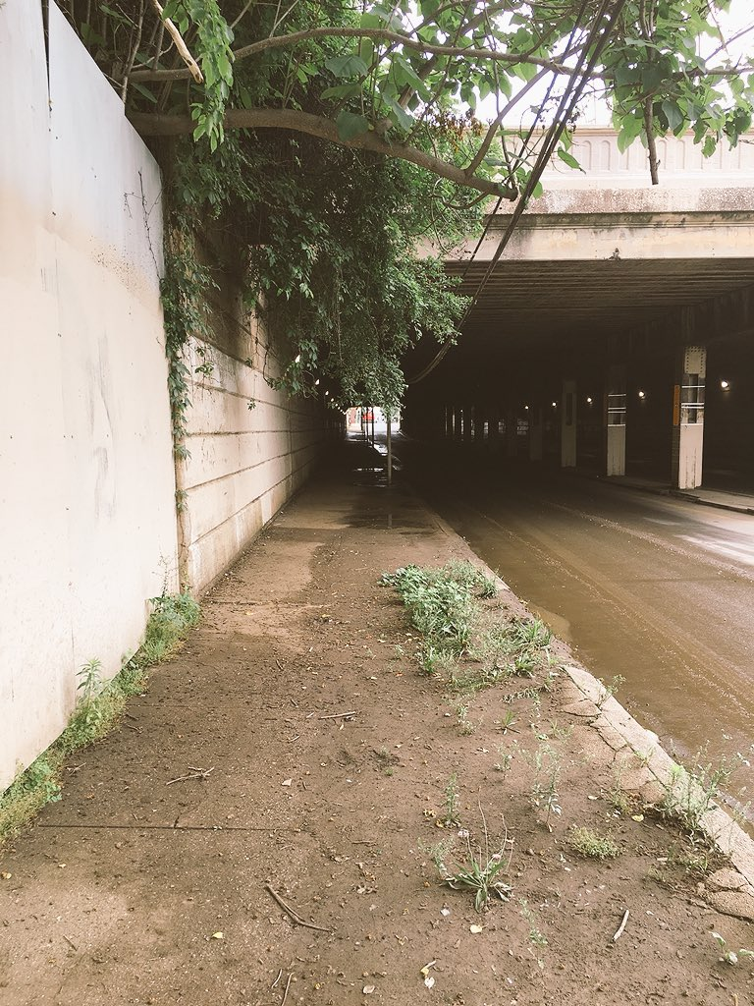
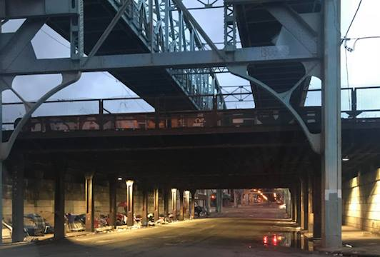
City’s Encampment Resolution Project

Slide 18
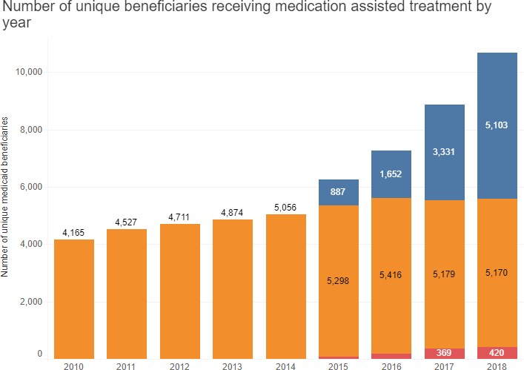
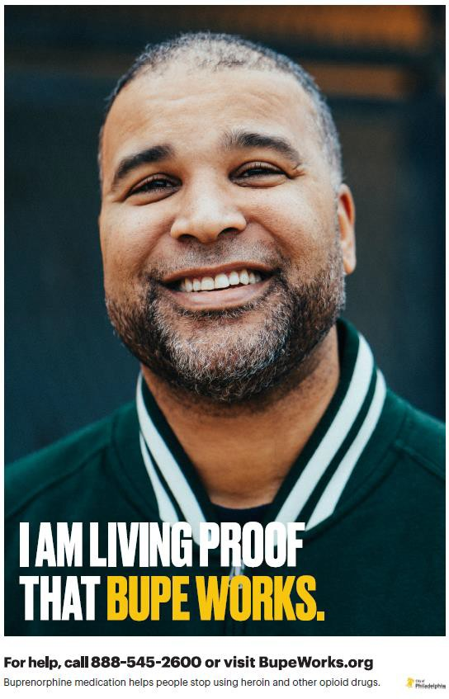
Treatment
Buprenorphine Methadone Naltrexone ER
PA DHS

Slide 19
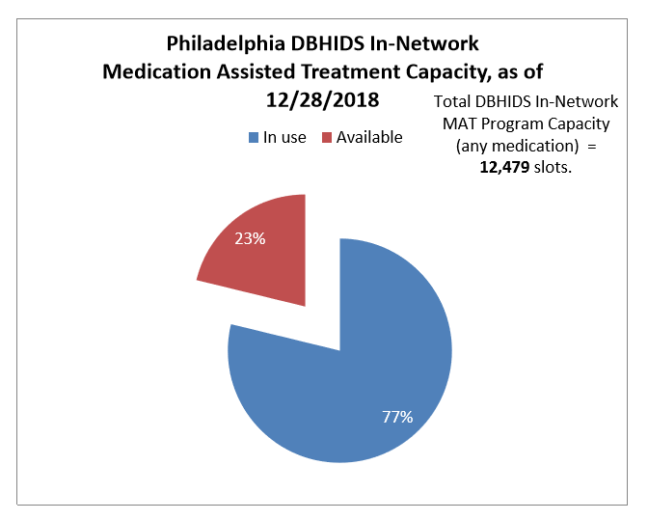

Slide 20
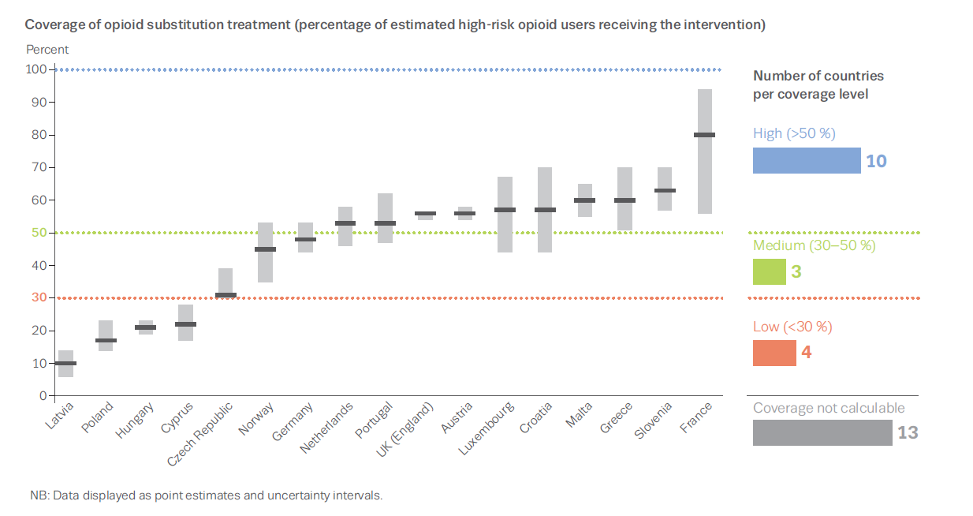

Maintenance treatment opioid dependent patients
Overall 48% of high-risk opioid users in Tx
USA 13%

Slide 21
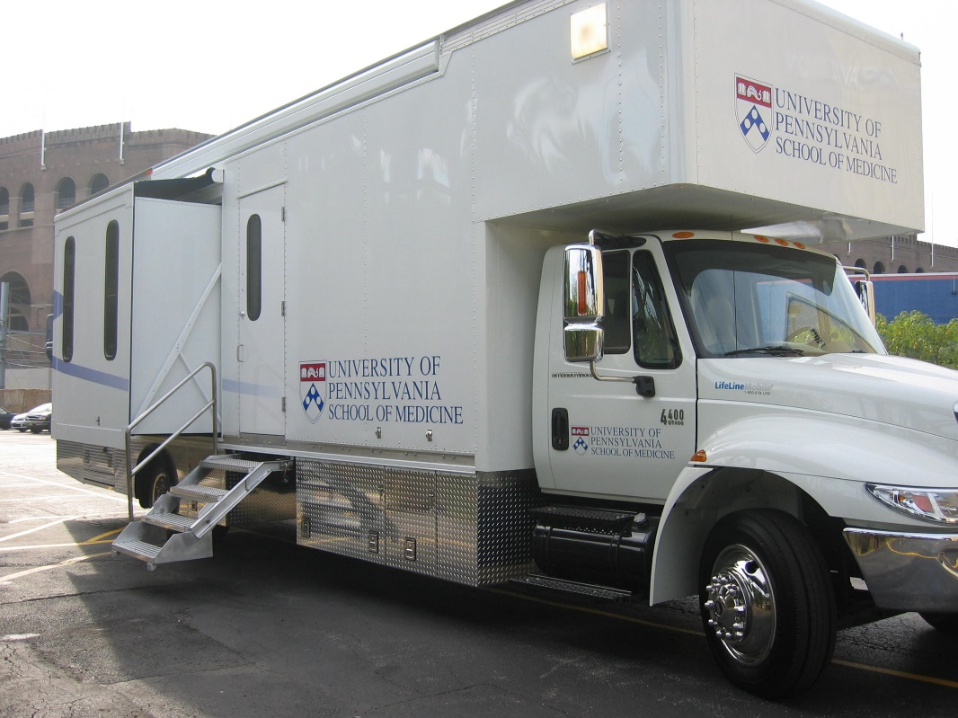
Rapid Initiation of buprenorphine/naloxone to optimize MAT in Philadelphia

Slide 22
RIDE Strategy
Mobile
Rapid relief of withdrawal symptoms
Preferred Provider Network
Support
Nurse practitioner
Case manager
Peer recovery specialist

Slide 23
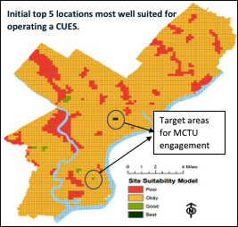
Targeted Neighborhoods

Slide 24
Conclusions
Philadelphia is experiencing a severe opioid epidemic
New strategies are needed for HIV prevention
MAT engagement remains challenging

